Slide 1
Live odds
A League of legends data science project

Slide 2
The goal of this presentation
This presentation has the goal to present the entire contents of the whole project in a 20-40 minute read, communicating ideas, thinking, findings and final results. Not all notebooks and datasets are going to be discussed (refer to README file for a more detailed description of every file in the directory).

Slide 3
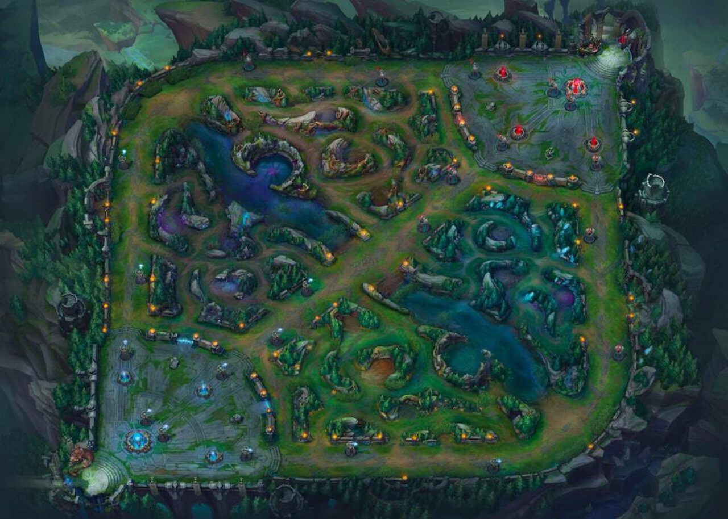

First, a bit about league of legends
Getting to know the basics of the game is crucial to understanding the project. League of Legends (or LoL for short) is a team-based game, usually played 5v5. The team that destroys the opponents main building, called Nexus, wins. Every players plays one, unique champion, each with 4 abilities. In order to destroy the nexus, you have to get gold - to be able to buy items to increase your stats, and experience - to gain levels to upgrade your abilities. You can do this by killing small NPC units called Minions, by killing an enemy champion or killing neutral monsters.
As you make your way to the enemy Nexus you have to destroy multiple other buildings, namely towers and inhibitors. Destroying turrets gives the entire team a bit more gold whereas destroying an inhibitor causes your team to spawn stronger minions to help you destroy the Nexus.

Slide 4
The modeling goal
The goal of the model I built here is to match, or even beat the probabilities that the bookies* present on their betting sites. With the “y” being the probability of the “Blue-side” team winning the game at the current point in the game, thus live odds are the numbers of interest.
*site of reference: https://www.lsbet.com

Slide 5
note
The first important thing to note is that the professional games are the games of interest and riot games (league of legends’ publisher) does not provide an official api to those games and long story short, that data is really hard to get your hands on. Even though I managed to get enough instances for the testing from professional games, the entire training data consists of amateur games that have an readily available api which makes it that much more practical. That means that the entire testing data is extrapolated.

Slide 6
Modeling & eda
Baseline modeling, feature selection and exploration

Slide 7
Baseline data columns are as it follows:
Blue_KillsTower – Amount of towers the blue team has destroyed.
Blue_KillsInhib – Amount of inhibitors the blue team has destroyed.
Blue_KillsBaron – Amount of Barons* the blue team has killed.
Blue_KillsDragon – Amount of dragons** the blue team has killed.
Purp_KillsTower
Purp_KillsInhib
Purp_KillsBaron
Purp_KillsDragon
Blue_Kills – Amount of kills*** the blue team has.
Blue_Assists – Amount of assists’ the blue team has.
Blue_Gold – Amount of gold the blue team has.
Purp_Kills
Purp_Assists
Purp_Gold

Slide 8
asterisks
*Baron is a neutral monster that once killed, gives a crucial team buff for a short period of time
**Dragons are neutral monsters that once killed, give a permanent, stacking team buff
***A kill (and with it, kill gold,) is awarded when your team kills an enemy player; A kill is awarded to the player that deals the killing blow
‘An assist (and with it, assist gold,) is awarded when you help your teammate kill an enemy player

Slide 9
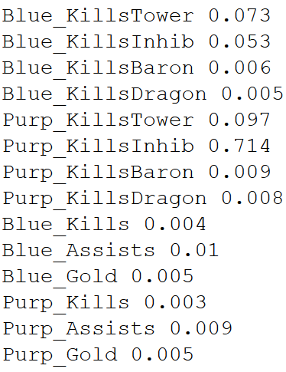
“BIRDS EYE VIEW”
Baseline model performance of a simple XGB classifier (Accuracy mean, std: 0.985, 0.002) doesn’t mean much for now since we are predicting on the games that are already finished (dataset consists of finished games’ stats). As I said, we are extrapolating and much more attention has to be paid to how models interact with features and less to how the model performs on training data.
As we can see on the picture, one feature prevails over the others: there are 2 likely explanations:
--- Feature correlation with y ---

Slide 10
THE FEATURE PROBLEM
1. Dominant feature/s
2. Features are highly correlated
Simply put, remember that we are using the data from finished games, so by just looking at it, we can most likely deduce which team finished with better stats and in return won. Another way to look at it: A minimal number of towers you have to destroy before getting to nexus is 5, so a team that has 4 towers simply cannot finish as a winner. In some cases it can, if the other team surrendered but then we can just look at the gold and see which team had the upper hand.
As we will see later (or as if you guessed if you played the game), all of the features are fully or partially tied to the “Total Gold” features, since gold is the core of making your team stronger and everything results in a bounty. This results in all the features carrying similar information so that means that the first splits and thus the dominant feature/s are most likely determined by chance or statistically insignificant higher margin of predictive power. Both problems are dealt with as we go on.

Slide 11
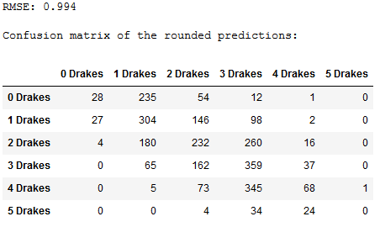
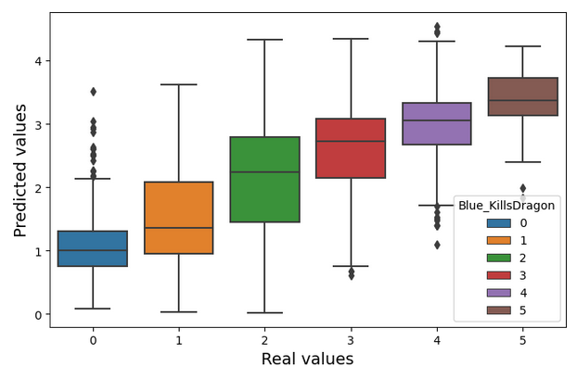
DRAGONS
As can be seen in the 5th cell of Models notebook, by repetitively removing the most dominant feature, retraining the model and showing feature importances again, the “Dragon” features never seem to show their importance which is counterintuitive since they give permanent buff (+4% bonus damage per dragon kill for example).
Different experiments didn’t yield any definitive conclusion so the only reasoning behind this behavior I can think of is that these bonuses only matter in the very late stages of the game when gold isn’t that big of a factor anymore (since you can only hold up to 6 items you buy with gold). There could be more research done on this topic but those sorts of very late games present a very small part of population so just keeping (in order to preserve information) and penalizing the features seems like a more practical and time-efficient solution.
--- using other features to predict the number of dragons,
explains correlation of “Dragon” with other features ---

Slide 12
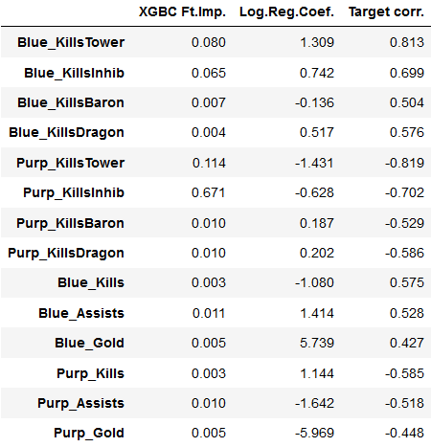
A better look at feature importances (some things to note)
XGBoost with default hyperparameters doesn’t seem like the best option for now since it finds the most dominant features in the upper nodes and then it doesn’t matter what it does later (this approach will probably generalize poorly).
If we look at the Logistic Regression Coefficient column it seems that some features’ parameters converged at “opposite” values (Blue_KillsBaron should clearly be in the positive). At this point, focusing on dealing with feature collinearity should be the top priority.
--- XGB feature importances, logistic regression coefficient and simple correlation with y ---

Slide 13
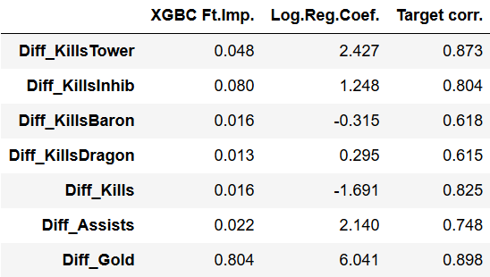
Solution: taking difference as “blue team features” – “pruple team features” = “difference data”
By doing this, we are cutting the feature space in half, which will help with model complexity, training time and most importantly, it will help with the reduction of between-the-feature correlation.
--- Features in the Difference Data ---

Slide 14
Things to note
In contrast to the pre-taking difference features, Gold now became the single most important feature in XGB Classifier
There are still some collinearity problems (all values in Log.Reg.Coef. column should be positive since the difference we are taking has the form of “Blue” – “Purp”)
Target correlation is significantly better

Slide 15
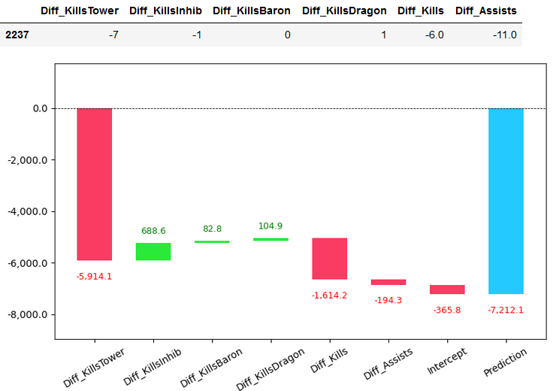
Underlying correlation with gold
Using other features to predict the Diff_Gold feature is the best example of how tied all the features are. Simple linear regression gives an RMSE of 2300 gold which is a relatively amazing number.
--- Linear Regression
Coefficients ---
--- Waterfall chart of a sample prediction ---

Slide 16
PCA
Even though I don’t prefer it, in the end, the only way I could effectively deal with between-the-feature correlation was shrinking data to 4 principal components in the modeling pipeline with minimal prediction power loses.

Slide 17
Evaluation
Evaluation on professional games

Slide 18
Ml pipeline
StandardScaler()
PCA()
LogisticRegression()

Slide 19
note
There is a caveat that has to be considered while evaluating a model. The test data was sampled from live games and that means that the samples are not independent. The way I dealt with this is taking folds of data where every fold consists of a single random sample from each game (22 games in total in my dataset). Another thing to note with this approach is that some games have only several instances (4 in some cases) so attention should be paid to not oversample those games (in this case, I resampled the data 5 times).

Slide 20
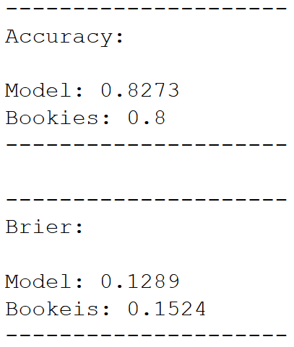
METRICS
Accuracy score and Brier’s score (~MSE) were used for evaluation of every data subsample and those results were averaged.
The final results are somewhat shocking given so many things the model could be improved on (more these things in the README file).

